Slide 1
DECISION SUPPORT AND INTELLIGENT SYSTEMS
Total Hour:7hrs
Presented by
Er.Harendra Bikram Shah
Lecturer
Department of BE Computer

Slide 2
OUTLINES
DSS, operation research Models
Group decision support system
Enterprise and Executive decision support systems
Knowledge Management, Knowledge based Expert System
AI, Neural Network, Virtual Reality, intelligent Agents
Data mining, Data Warehousing, OLAP and OLTP
Anomaly and fraud Detection

Slide 3
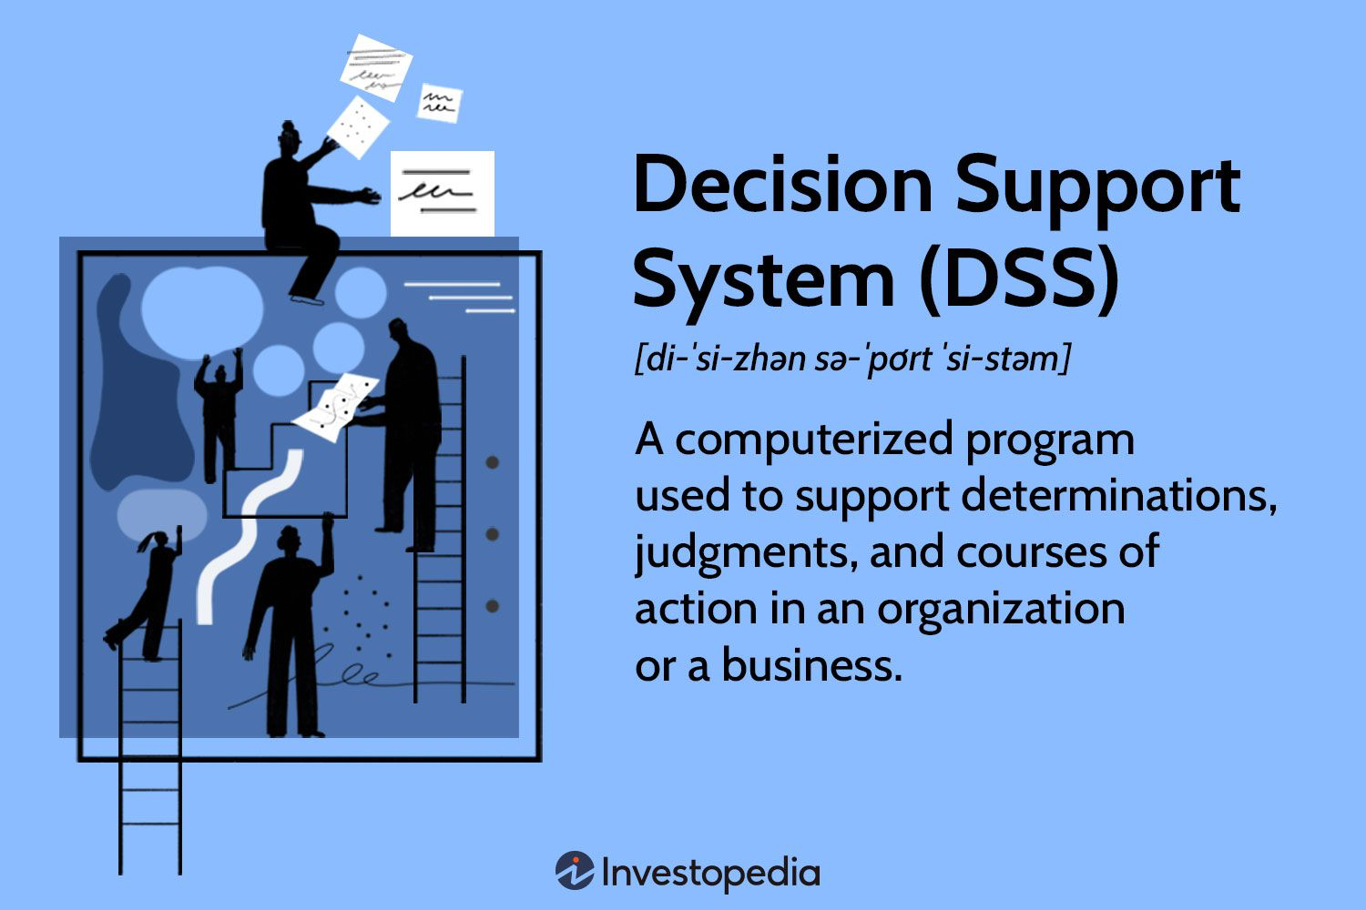
Concept of Decision Support System (DSS)
Type of information system designed to assist decision-makers in making better, more informed decisions.
It provides tools, data, and analytical capabilities to support decision-making processes across various domains and levels of an organization
Decision-making =>The action of selecting among alternatives.

Slide 4
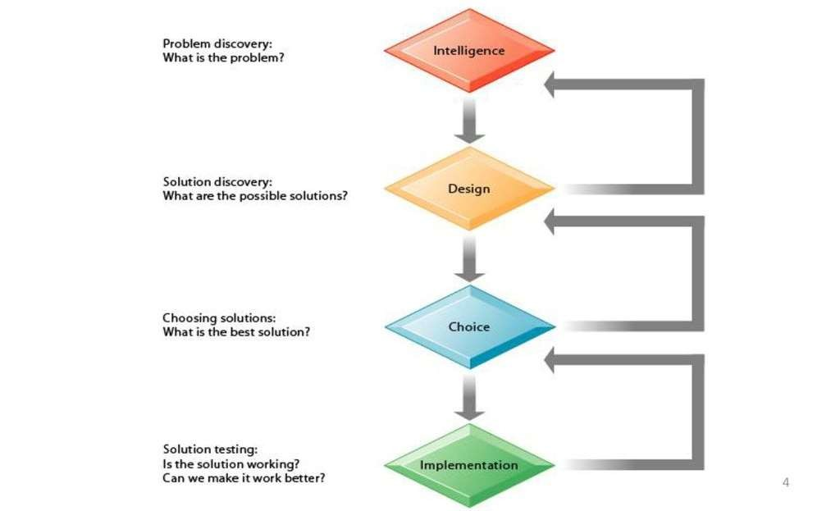
Phases of Decision Support System (DSS)

Slide 5
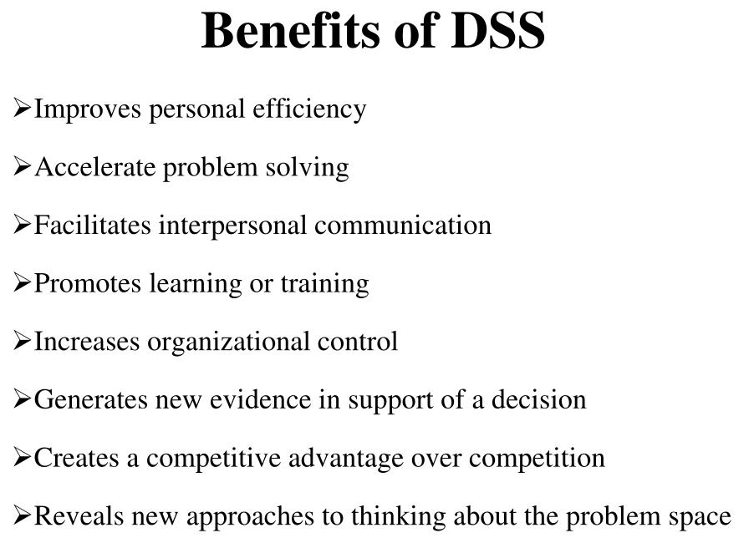

Slide 6
Cons of Decision Support System (DSS)
Overload Information
Reduction of status
Unanticipated effects
Cost in Monetary
Too much DSS dependency

Slide 7
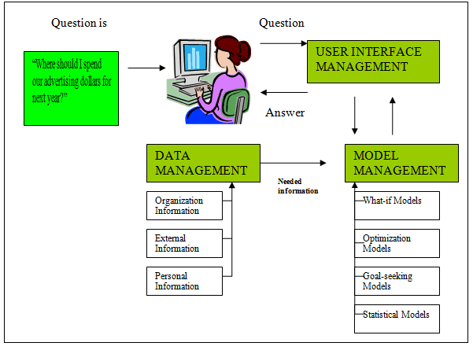
Components of Decision Support System (DSS)

Slide 8
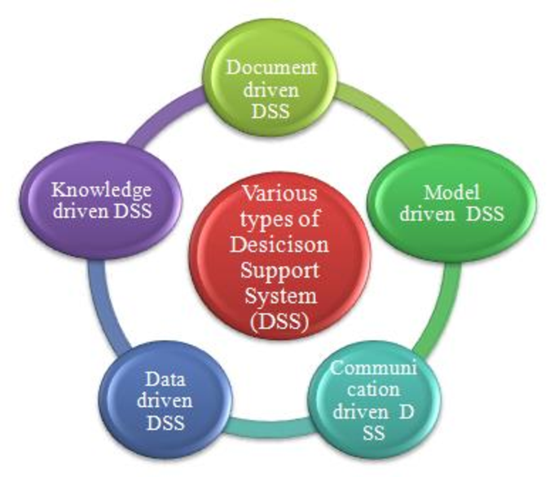
Types of Decision Support System (DSS)

Slide 9
Uses of Decision Support System (DSS)
1.Healthcare Management:
2.Financial Analysis and Investment:
3.Supply Chain Management:
4.Marketing and Customer Relationship Management (CRM):
5.Manufacturing and Operations Management:
6.Environmental Management:
7.Emergency Response and Disaster Management:

Slide 10
Operation Research Models
The Operation Research Models are the mathematical models in providing guidelines to managers for making effective decisions within the state of the current information, or in seeking further information if current knowledge is insufficient to reach a proper decision.
Some Applications:
Telecommunications/Roads/Rail Network Design
Organization Supply Chain Strategy
Just-in-Time Manufacturing Planning
Retail Shop floor Layout
Revenue, Pricing and Promotions
Demand Forecasting
Project Planning

Slide 11
For Example:
Linear Programming is mathematical modeling technique useful for guiding quantitative decisions in business planning, industrial engineering.
Network Flow Programming
Integer Programming
Nonlinear Programming
Dynamic Programming
Simulation
Queuing

Slide 12

Group Decision Support System (GDSS)
GDSS are computer-based systems designed to support group decision-making processes by providing tools and technologies that facilitate communication, collaboration, and information sharing among group members.
These systems are commonly used in business, government, and academic settings to enhance the effectiveness and efficiency of group decision-making processes.

Slide 13
Features of Group Decision Support System (GDSS)
Ease of use
Better Decision Making
Emphasis on Semi-structured and Unstructured Decisions
Specific and General Support
Supports all Phases of the Decision Making
Supports Positive Group Behavior

Slide 14
Advantages of GDSS
More precise communication
Improves personal efficiency
Promotes learning or training
Promotes group work in other areas
Synergy (building on ideas of others)
Objective evaluation of ideas
Increased participation due to stimulation of individuals
Possibility of global participation
Disadvantages of GDSS
Cost:
Security:
Technical Failure:

Slide 15



5.4.1.1 Phases of GDSS process
Issue categorization & analysis
Ranking & Voting
Brainstorming
Brainstorming – group members will come up with ideas to solve problem
Issue categorization & analysis – group members will sort the ideas based on the classification & the idea will be evaluated.
Ranking & voting – every group member will chose the suitable ideas in solving the problem. Highest voted idea will be selected.

Slide 16
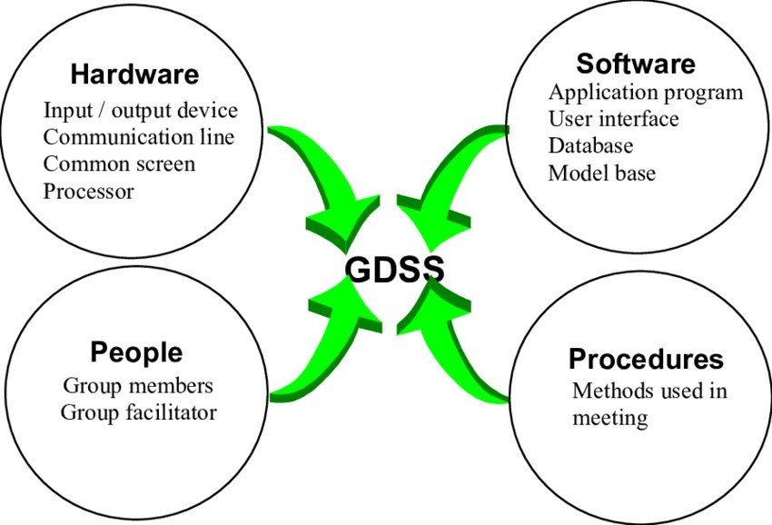
5.4.1.2 Components of GDSS
A group decision support system (GDSS) is composed of 3 main components, namely hardware, software tools, and people.

Slide 17
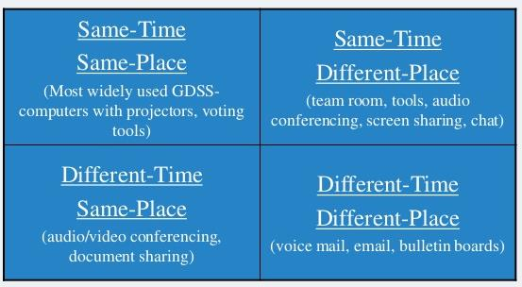
Different kinds of GDSS based on Time/place:

Slide 18
Enterprise decision support systems
software applications designed to assist in decision-making processes within organizations.
key components and features of Enterprise Decision Support Systems:
Data Integration:
Analysis and Visualization:
Collaboration:
Customization:
Scalability:
Security:
Integration with other Systems:

Slide 19
Executive decision support systems
An executive decision support system is a type of computerized IS designed to aid business executives in the decision-making process.
These systems provide strategic decision support by offering insights, analysis, and information relevant to high-level management decisions.
key features and characteristics of Executive Decision Support Systems:
Aggregating Information:
Strategic Focus:
Visualization and Dashboards:
Scenario Planning:
Risk Analysis:
Forecasting and Predictive Analytics:
Decision Collaboration:
Real-time Updates:
Integration with Business Processes:
Security and Privacy:

Slide 20
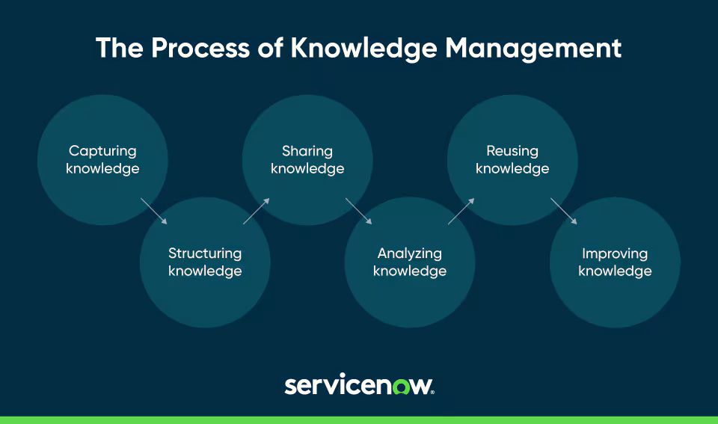
Knowledge Management
process of identifying, creating, sharing, and effectively utilizing knowledge within an organization.

Slide 21
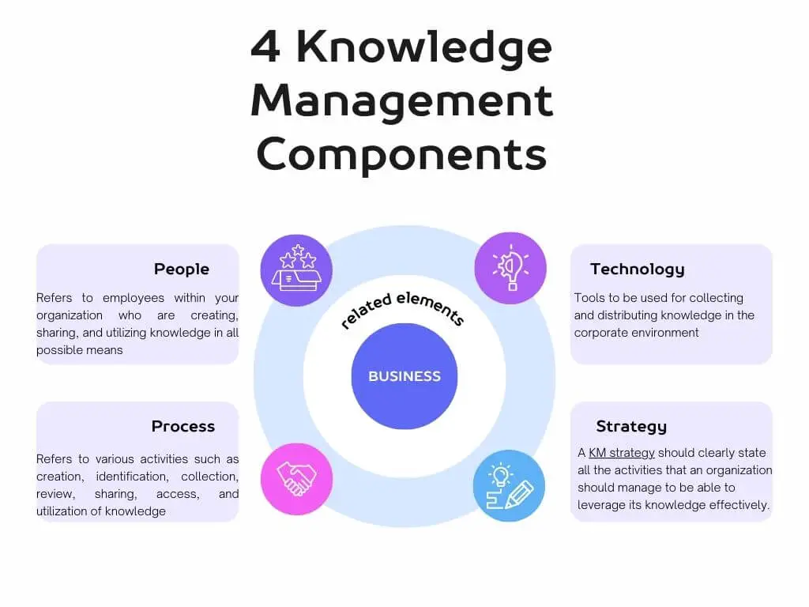
Components of Knowledge Management

Slide 22
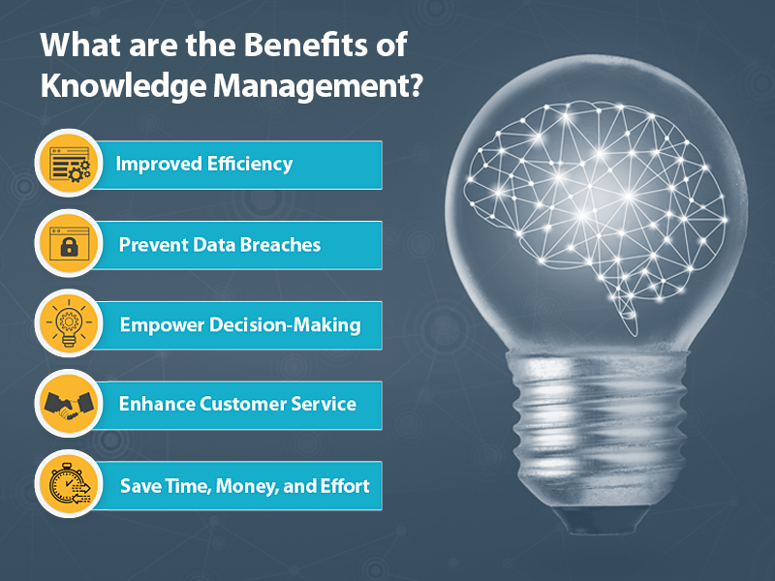
Benefits of Knowledge Management

Slide 23
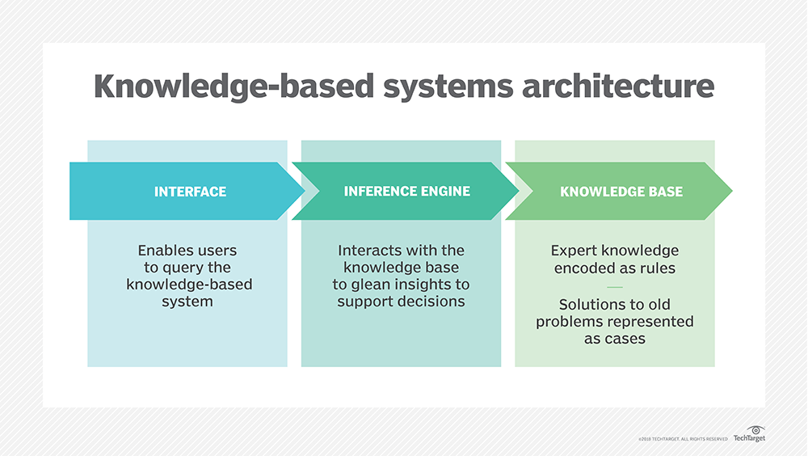
Knowledge Based System
They are form of artificial intelligence (AI) designed to capture the knowledge of human experts to support decision-making

Slide 24
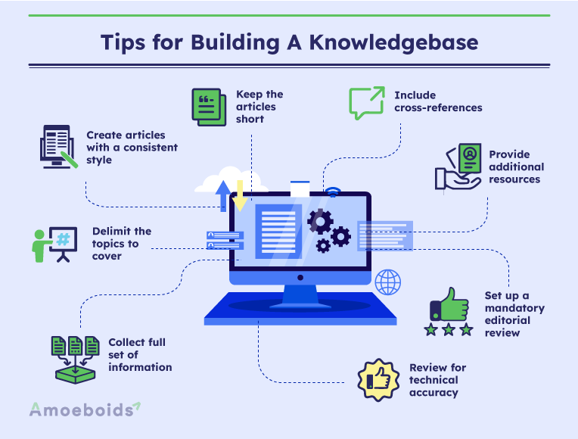
Knowledge Base
Library of Knowledge

Slide 25
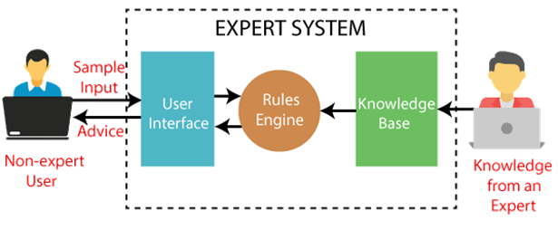
Expert System
computer program that is designed to solve complex problems and to provide decision-making ability like a human expert.
Components of an Expert System

Slide 26
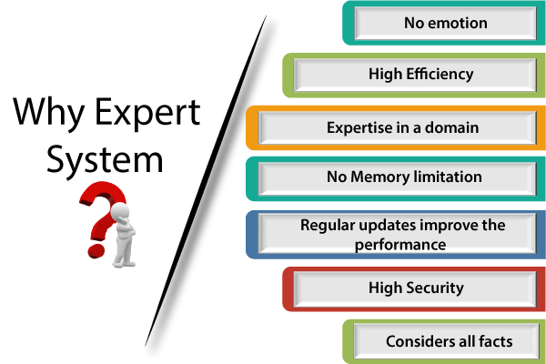
Expert System

Slide 27
Expert System
Advantages of Expert System
These systems are highly reproducible.
They can be used for risky places where the human presence is not safe.
Error possibilities are less if the KB contains correct knowledge.
The performance of these systems remains steady as it is not affected by emotions, tension, or fatigue.
They provide a very high speed to respond to a particular query.
Limitations of Expert System
The response of the expert system may get wrong if the knowledge base contains the wrong information.
Like a human being, it cannot produce a creative output for different scenarios.
Its maintenance and development costs are very high.
Knowledge acquisition for designing is much difficult.
For each domain, we require a specific ES, which is one of the big limitations.
It cannot learn from itself and hence requires manual updates.

Slide 28
Applications of Expert System
In designing and manufacturing domain
In the knowledge domain
In the finance domain
In the diagnosis and troubleshooting of devices
Planning and Scheduling
Characteristics of Expert System
High Performance
Understandable:
Reliable:
Highly responsive:

Slide 29

AI[Artificial Intelligence]
Branch of Computer science that deals with making things intelligent
John McCarthy

Slide 30
Domains of Artificial Intelligence
Cognitive science:
Focuses on researching how the human brain works & how humans think and learn
Applications:
Expert systems
Adaptive learning systems
Fuzzy logic systems
Neural networks
Intelligent agents
Robotics:
Produces robot machines with computer intelligence and computer controlled, human like physical capabilities
Natural interfaces:
Natural language and speech recognition
Talking to a computer and having it understand
Virtual reality
45

Slide 31
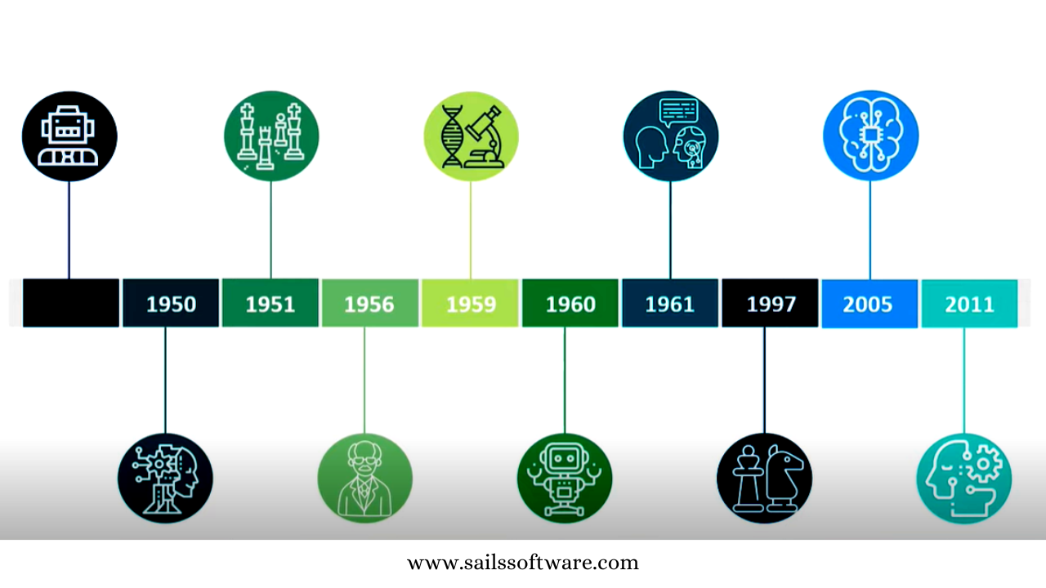
History of AI

Slide 32
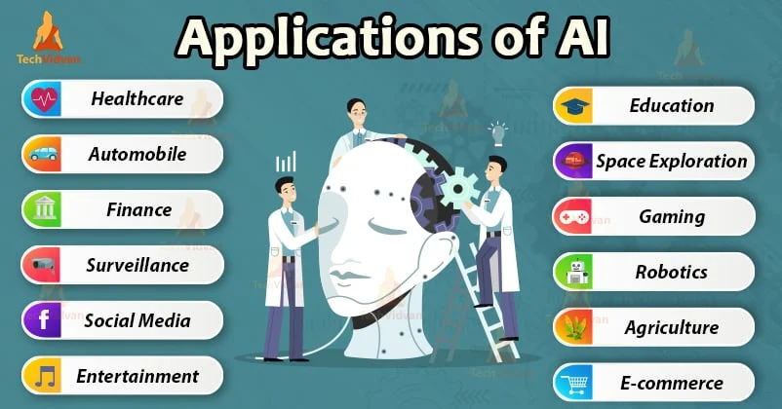
Applications of AI

Slide 33
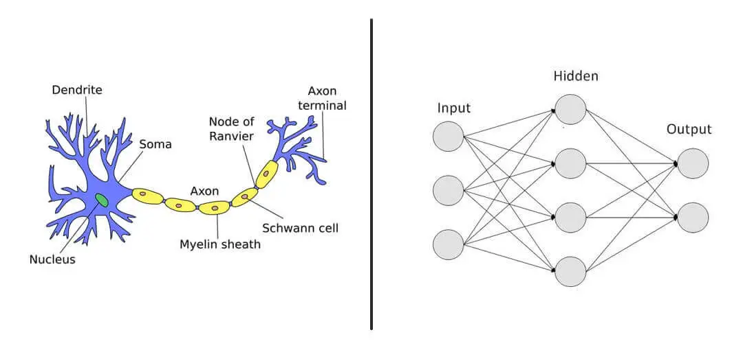
Neural Network/ANN
method in artificial intelligence that teaches computers to process data in a way that is inspired by the human brain.

Slide 34
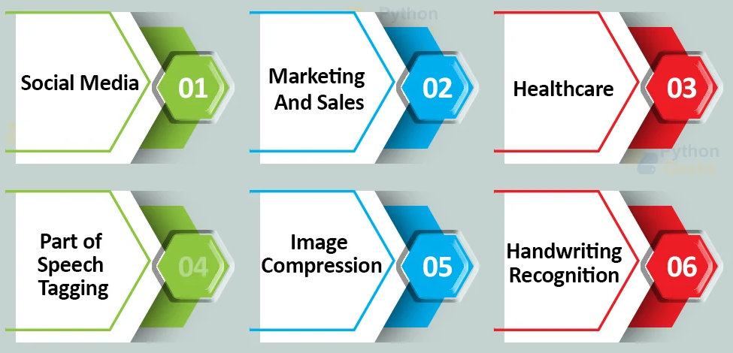
Applications of Neural Network/ANN

Slide 35

Virtual Reality
virtual reality (VR), the use of computer modeling and simulation that enables a person to interact with an artificial three-dimensional (3-D) visual or other sensory environment.

Slide 36
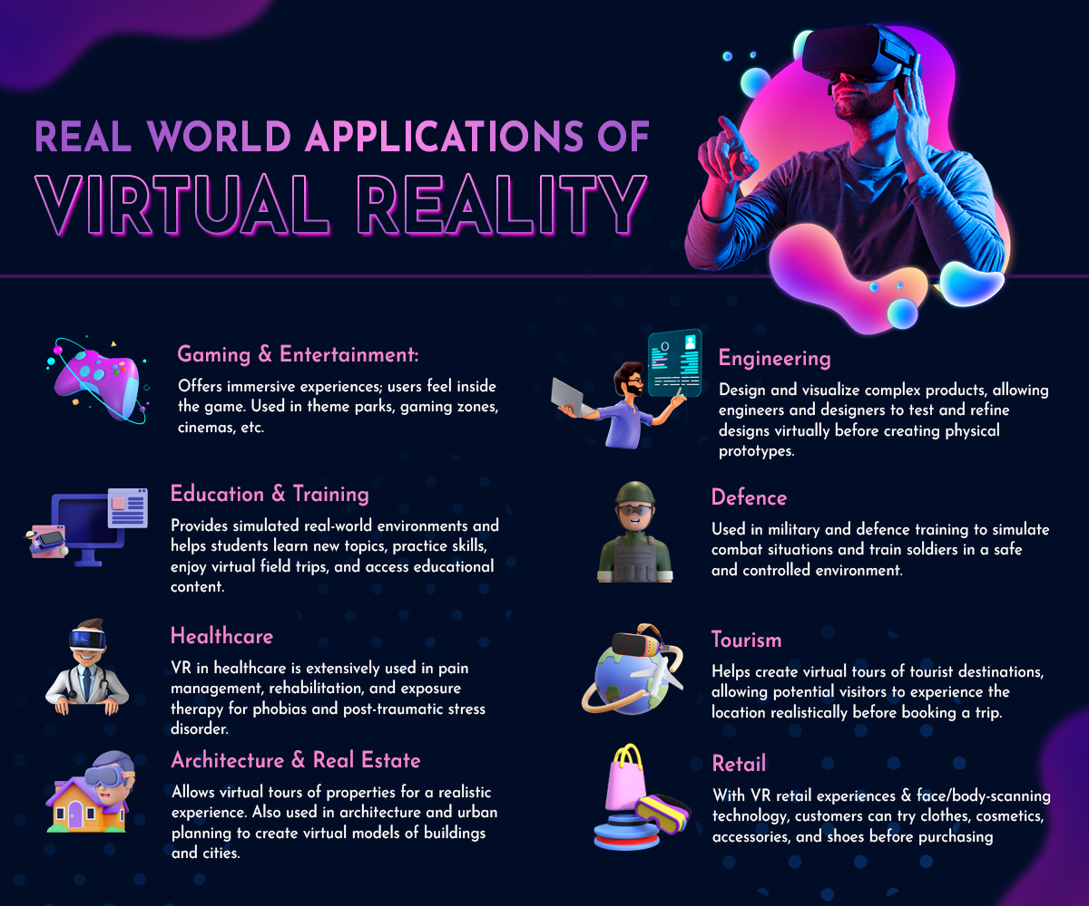
Applications of Virtual Reality

Slide 37
Intelligent Agents
AI has agents to perform its task
An agent can be anything that understands environment through sensors and act upon that environment through actuators.
An Agent runs in the cycle of perceiving, thinking, and acting.
An agent can be:
Human-Agent:
eyes, ears, and other organs which work for sensors and hand, legs, vocal tract work for actuators.
Robotic Agent:
A robotic agent can have cameras, infrared range finder, NLP for sensors and various motors for actuators.
Software Agent:
keystrokes, file contents as sensory input and act on those inputs and display output on the screen.
Example:
Alexa and Siri etc.

Slide 38
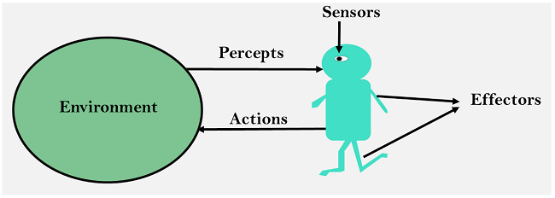
Intelligent Agents
Sensor:
Sensor is a device which detects the change in the environment and sends information.
Actuators:
Actuators are the component of machines that converts energy into motion.
An actuator can be an electric motor, gears, etc.
Effectors:
Effectors are the devices which affect the environment.
Effectors can be legs, wheels, arms, fingers, wings, fins, and display screen.

Slide 39
Types of Intelligent Agents
Intelligent Agents
An autonomous entity which act upon an environment using sensors and actuators for achieving goals.
An intelligent agent may learn from the environment to achieve their goals.
A thermostat is an example of an intelligent agent.
Following are the main four rules for an AI agent:
Rule 1: An AI agent must have the ability to perceive the environment.
Rule 2: The observation must be used to make decisions.
Rule 3: Decision should result in an action.
Rule 4: The action taken by an AI agent must be a rational action.
Simple Reflex Agents.
Model-Based Reflex Agents.
Goal-Based Agents.
Utility-Based Agents.
Learning Agent.

Slide 40
Data mining, Data Warehousing, OLAP and OLTP
It is the process used to find new, hidden or unexpected patterns in data to predict the future of the data
Process of Finding the required pattern from huge mass of Data.
What is not Data Mining?
Look up phone number in phone directory.
Query a Web search engine for information about “Amazon”.
What is Data Mining?
Certain names are more prevalent in certain US locations (O’Brien, O’Rurke, O’Reilly… in Boston area).
Group together similar documents returned by search engine according to their context (e.g. Amazon rainforest, Amazon.com).

Slide 41
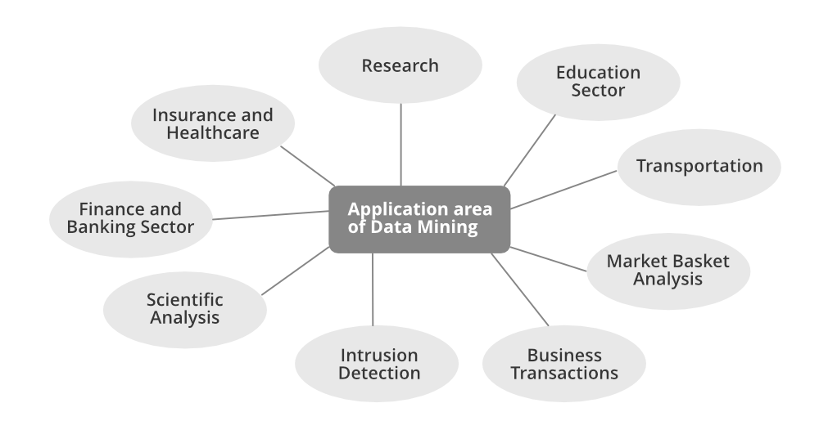

Slide 42
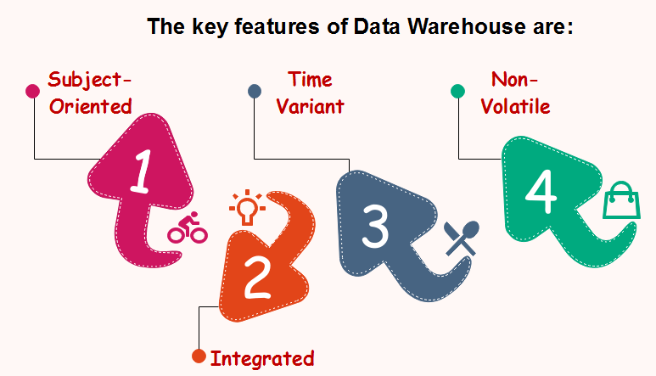
Data Warehousing
A data warehouse is a large collection of business data used to help an organization make decisions
Repository of HIstorical Data.
Data warehousing is an electronic method of organizing information.

Slide 43
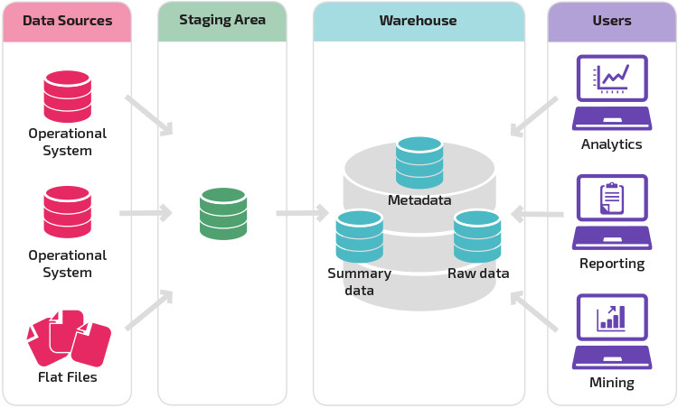
Basic Structure of Data Warehousing

Slide 44
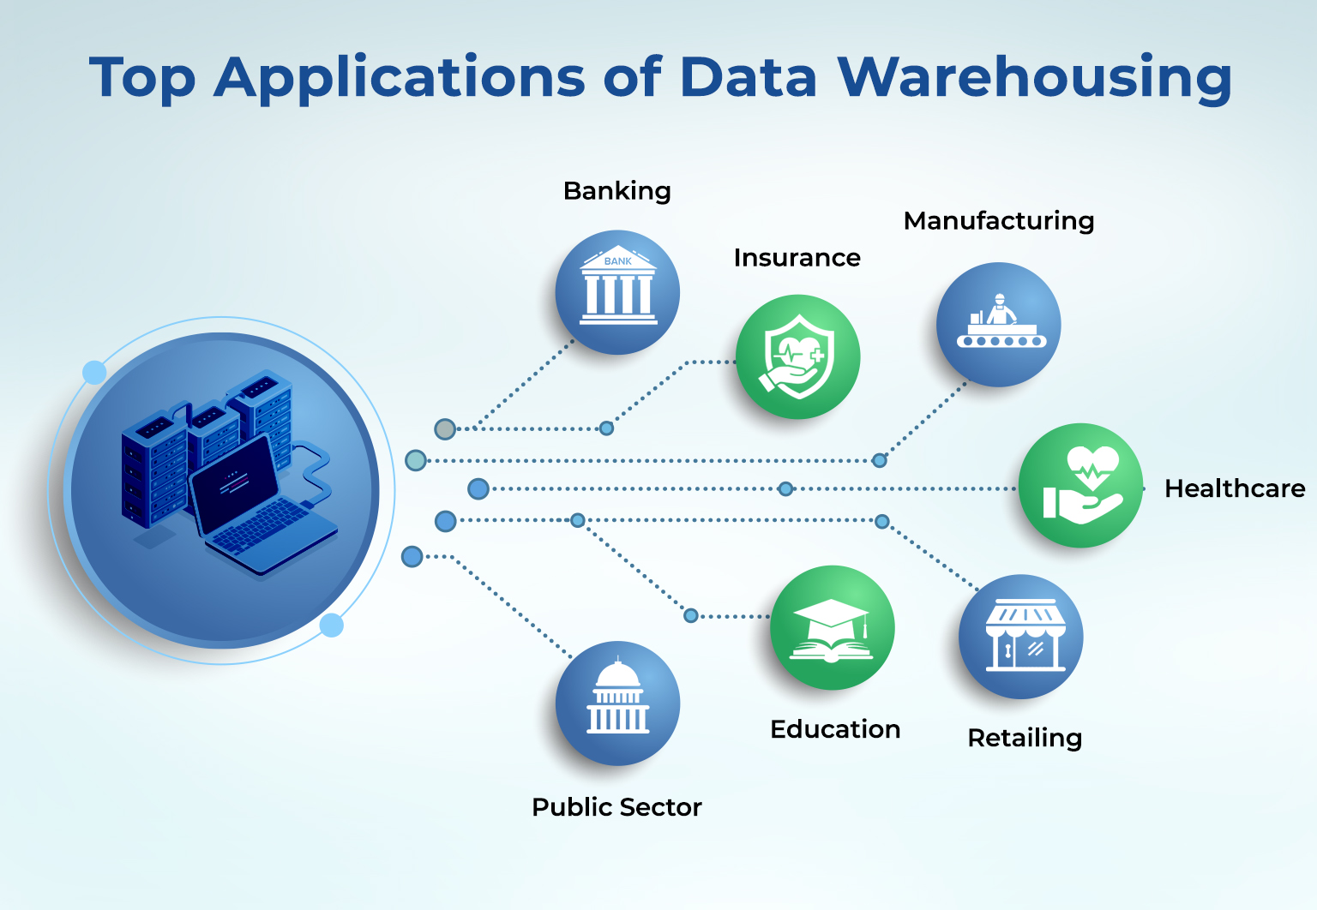
Uses of Data Warehousing

Slide 45
OLAP and OLTP
OLAP stands for Online Analytical Processing.
OLAP systems have the capability to analyze database information of multiple systems at the current time.
The primary goal of OLAP Service is data analysis and not data processing.
OLTP stands for Online Transaction Processing.
OLTP has the work to administer day-to-day transactions in any organization.
The main goal of OLTP is data processing not data analysis.
OLAP Examples
Spotify analyzed songs by users to come up with a personalized homepage of their songs and playlist.
Netflix movie recommendation system
OLTP Examples
ATMs,
financial transaction systems
online banking applications etc.

Slide 46
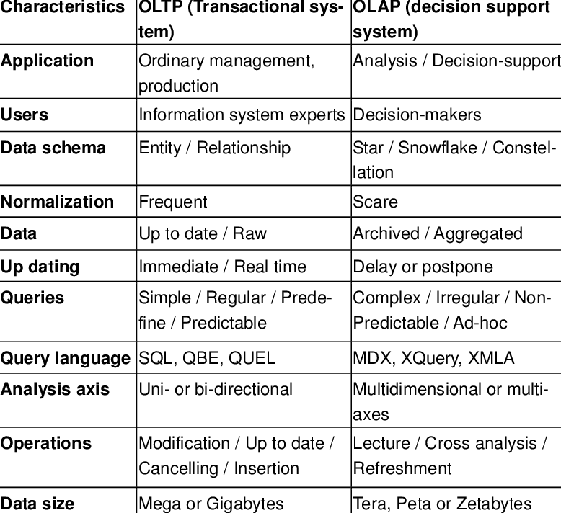

Slide 47
Anomaly Detection
Anomaly detection in information systems involves identifying unusual or abnormal behavior within the data generated by the system.
Applications:
1. Network Intrusion Detection:
2. System Performance Monitoring:
3. User Behavior Analysis:
4. Application Performance Monitoring (APM):
5. Fraud Detection:

Slide 48
Fraud Detection
It is a critical component of maintaining security and integrity in various domains, including finance, e-commerce, healthcare, and more.
Fraud detection approach in information systems:
1. Data Collection:
2. Data Preprocessing:
3. Feature Extraction:
4. Model Training:
5. Model Evaluation:
6. Deployment and Monitoring:
7. Feedback Loop:

Slide 49
END of The Unit 4

